Slide 1


ONLINE EXAMINATION SYSTEM
Business intelligence track
Menofia branch

Slide 2
WHO WE ARE?
Abdelrahman Ahmed
Ahmed Magdy Elgalf
Ahmed Mabrouk
Fatma Elzahraa
Rana Meshref

Slide 3
PROJECT PHASES
Phase 01
ERD
Phase 03
Reporting
Phase 02
Mapping
Initial data
Stored Procedures
Design Apps
Dashboards

Slide 4





Project Timeline methodology
Scope Meetings
We argued about how is project must go, and every member knew her/his role.
Analyzing the requirements was our priority to meet the output (products) with it.
Confirming the technology and put our first steps was our second one.
Database building
Designing ERD and Mapping.
Setting our tables and determine the primary and foreign keys.
Apply it on SQL server beside put our initial data to fill it.
Requirements Engineering
Implementation
Testing & Reporting
Design our Apps UI to know what procedures we need. Build our backend apps using C#
Test our code and made sure that apps runs correctly.
Build our reports and dashboards to show them in the Instructor’s app.

Slide 5

TECHNOLOGIES USED
SQL Server
SSRS
SSIS
C#
Visual Studio
Power BI
Diagrams (mapping and ERD)
dbFrog (Documentation)

Slide 6
PRODUCTS
ER Diagram
Mapping
49 Stored procedures
APP
Reports
Dashboards
Documentation

Slide 7
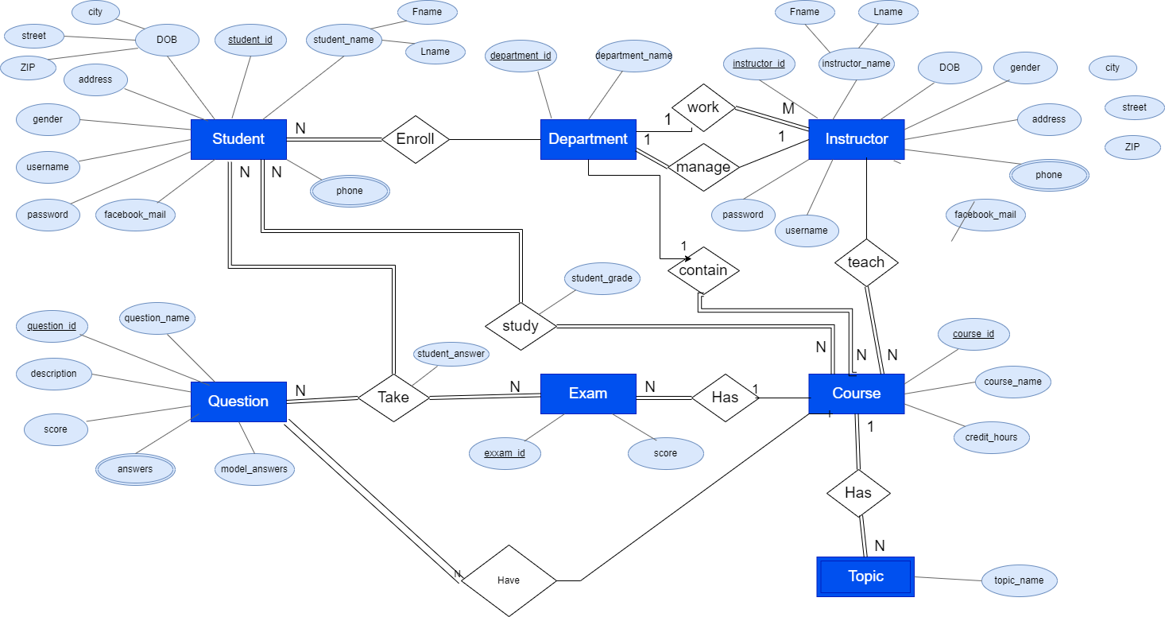
ERD

Slide 8
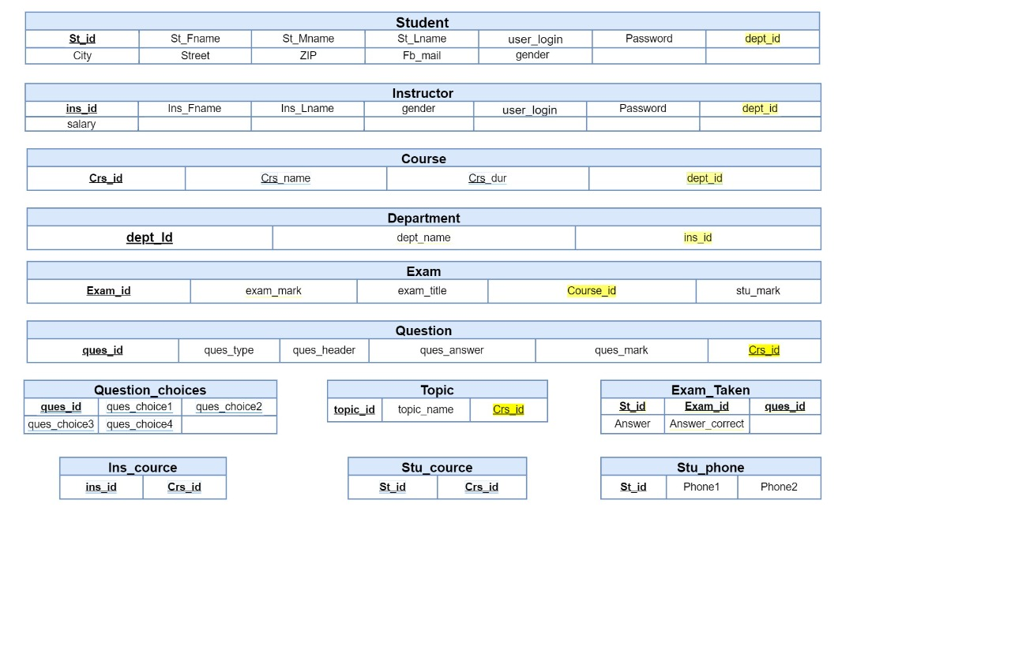
Mapping

Slide 9
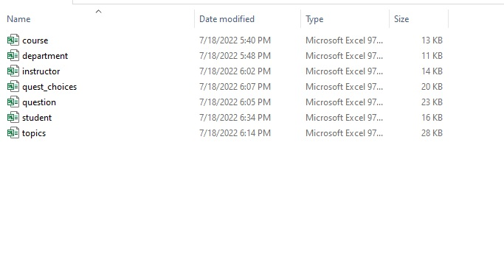
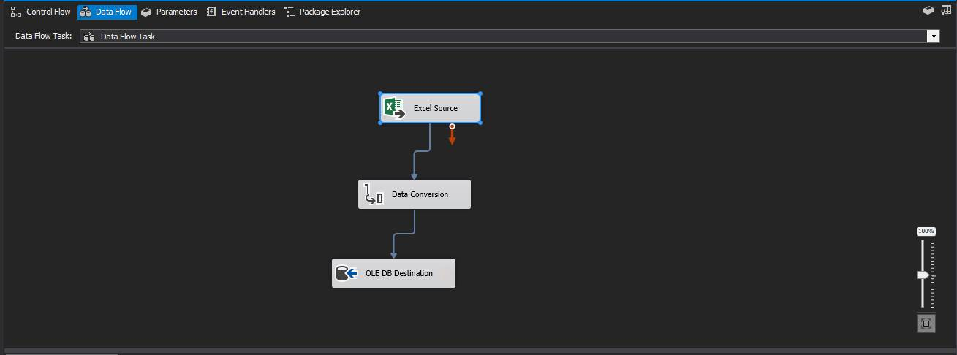
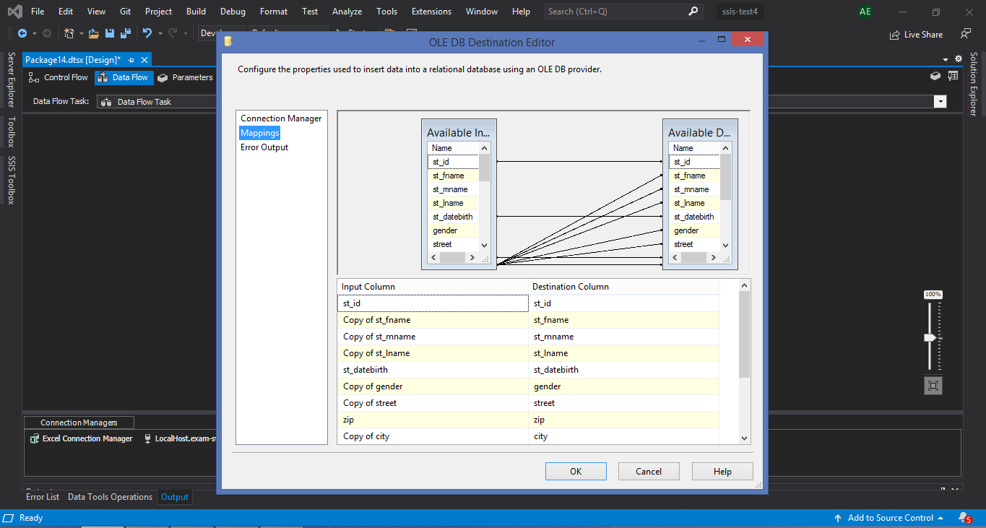
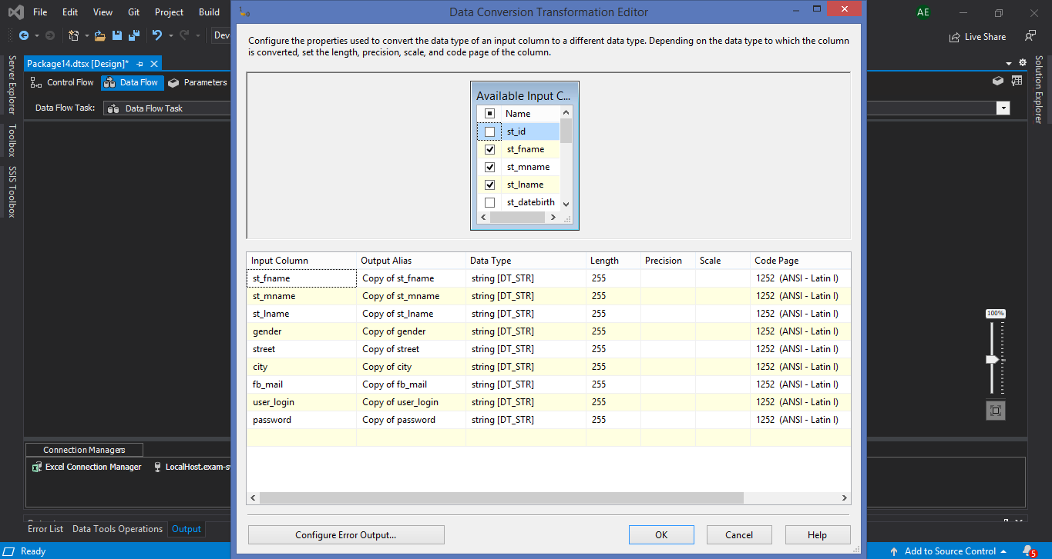

Slide 10
Exam Desktop Application
Initializing the app
After registration, the student can login normally
Login form (1st form)
Registration form (2nd form)
If the student uses the app for the first time
The student adds his data to be saved in the database
Message (“invalid email or password”)
If =login false
If login = true
Shows the result in %
Result form (5th form)
Saving the exam questions, answers, and exam id in the database
The student chooses the course he wants to have exam in
Exam is here generated with random exam no.
Courses choosing form (3rd form)
Generating the exam
Exam form (4th form)

Slide 11
Instructors Desktop Application
Initializing the app
Login form (1st form)
Message (“invalid email or password”)
instructors button
If login = false
If login = true
Instructors form
Generates reports

Slide 12
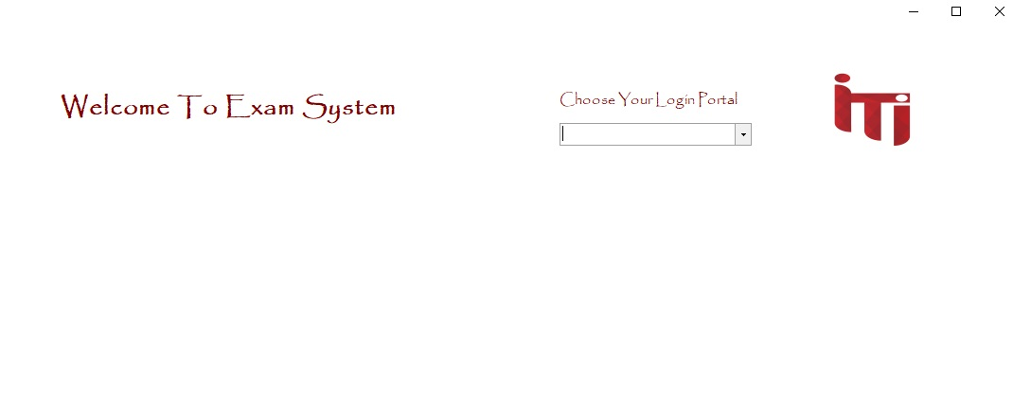
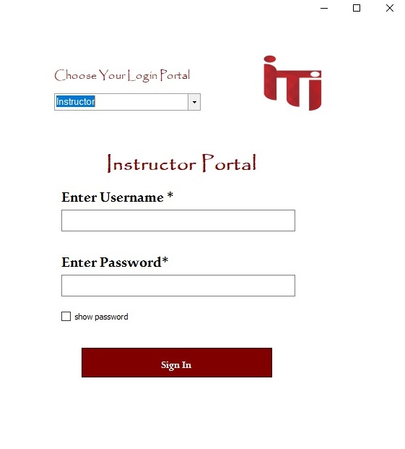
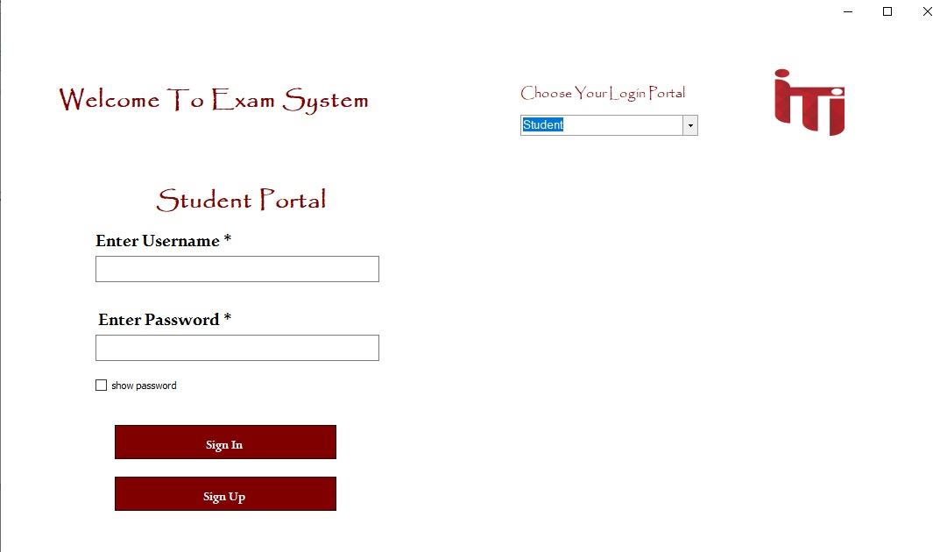

Slide 13
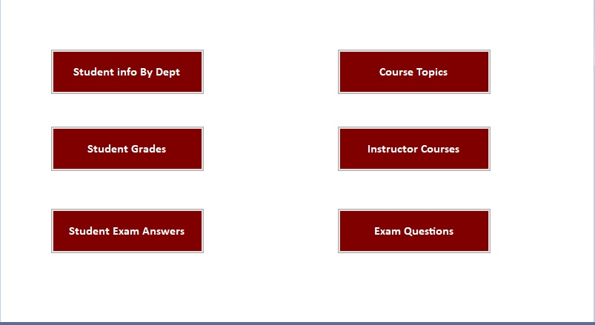
Home Ins.Reports

Slide 14
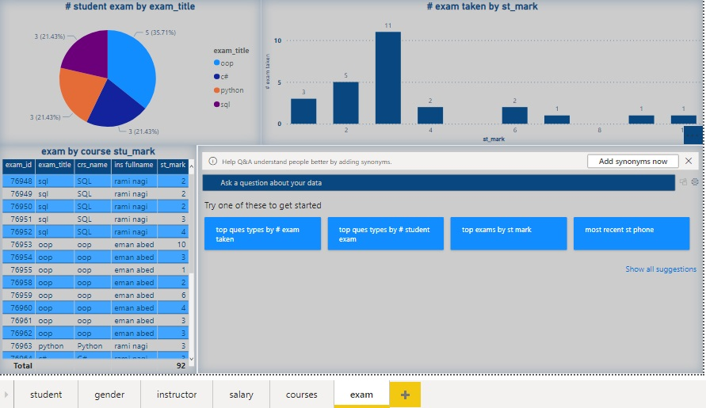
DASHBOARDS

Slide 15
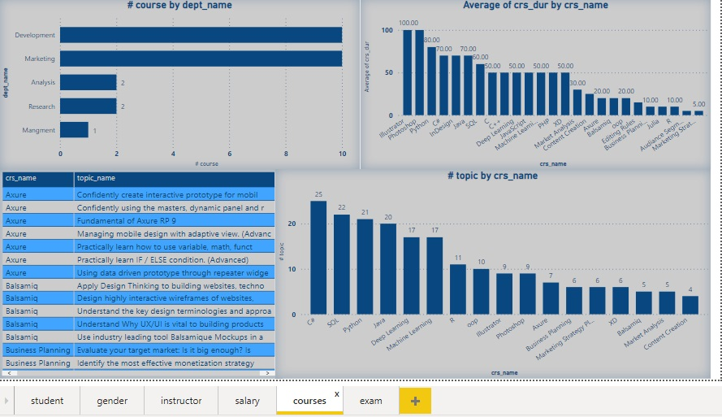

Slide 16
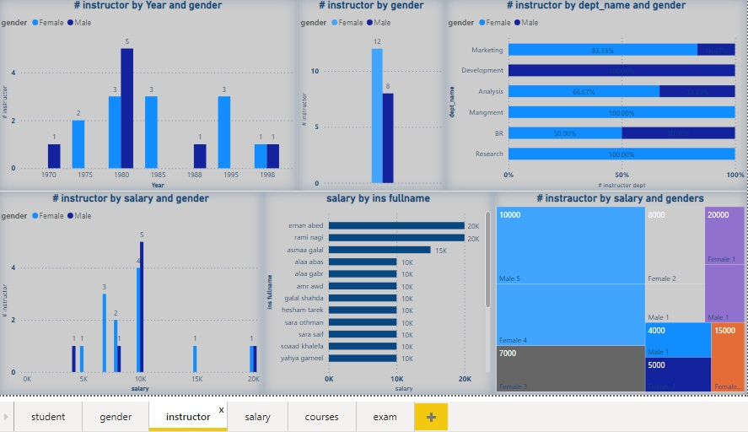

Slide 17
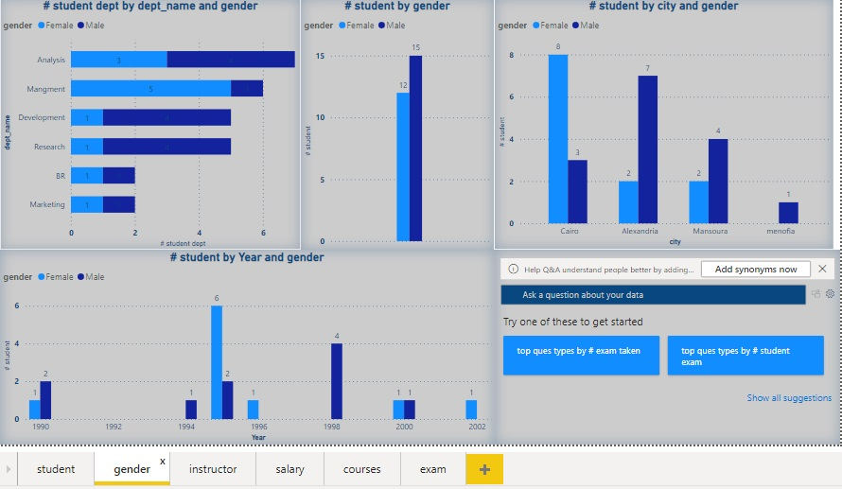

Slide 18
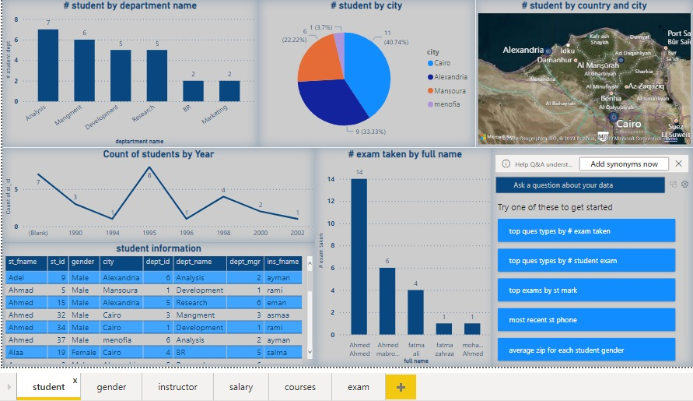

Slide 19
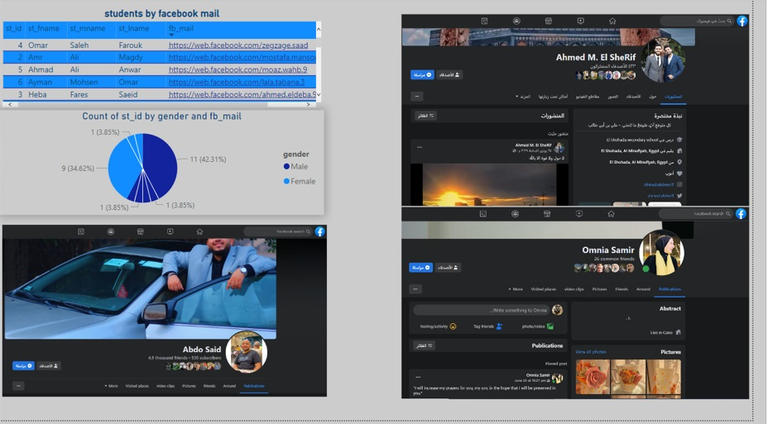

Slide 20
ANY QUESTIONS..?

